Slide 1

GUJARAT TECHNOLOGICAL UNIVERSITY
AI-Powered Investigation & Incident Response
PROJECT TITLE: [ ANISAS ]
TEAM NAME
TEAM LEADER
TEAM MEMBERS
[ The Midnight Malwares ]
[ Preetansh Gohil ]
[ Vibhuti Gosai, Ricky Makwana, Poojan Joshi & Mahek Valecha ]
Final Presentation
24th July 2026
Gujarat Technological University (GTU)

Slide 2




Problem Statement
Problem Context
Domain Importance
Challenges & Gaps
Modern organizations rely on multiple standalone security tools to perform network reconnaissance, vulnerability assessment, IoT discovery, and risk analysis. This fragmented approach increases investigation time and often leaves critical security gaps unnoticed.
Why this problem is important
Increasing cyber threats demand rapid security assessments.
Enterprise networks contain diverse devices, including IoT systems.
Manual analysis is time-consuming and error-prone.
Security teams require centralized visibility of network assets.
Multiple disconnected security tools
Manual network investigation
Limited asset visibility
Slow incident response
Lack of automated risk analysis
•
Bootcamp on Intelligent Cyber Forensics
Gujarat Technological University

Slide 3


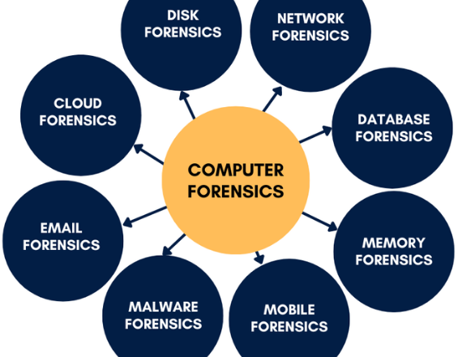

Domain & Relevance
Real-World Relevance & Use Case
ANISAS provides an AI-powered platform that automates network discovery, device identification, security assessment, and report generation from a single target IP, enabling faster and more efficient security investigations.
Who Will Benefit?
Who will benefit
Security Operations Center (SOC) Teams
Network Administrators
Penetration Testers
Cybersecurity Consultants
Government & Enterprise Organizations
Bootcamp on Intelligent Cyber Forensics
Gujarat Technological University

Slide 4
Proposed Solution Overview
Solution Description
Key Objectives
ANISAS is an autonomous network intelligence platform that integrates multiple reconnaissance and security assessment modules into a unified system. It automates device discovery, threat analysis, and professional report generation.
Automate network reconnaissance
Identify network assets and IoT devices
Detect security perimeter devices
Perform AI-driven risk analysis
Generate visual reports and security summaries
Bootcamp on Intelligent Cyber Forensics
Gujarat Technological University

Slide 5

Technical Architecture & Workflow
The system architecture follows a modular pipeline designed for real-time artifact ingestion, agentic reasoning, and interactive forensic report presentation.
Key Architectural Components
ASN Intelligence Module
Network Scanner
Security Perimeter Detection
IoT Fingerprinting
Wireless Analysis
AI Analytics Engine
FastAPI Dashboard
Target IP
│
▼
ASN & ISP Intelligence
│
▼
Network Reconnaissance
│
▼
Firewall & IDS Detection
│
▼
IoT Device Fingerprinting
│
▼
Wireless Network Intelligence
│
▼
AI/ML Analytics Engine
│
▼
Dashboard & PDF Report
Bootcamp on Intelligent Cyber Forensics
Gujarat Technological University

Slide 6

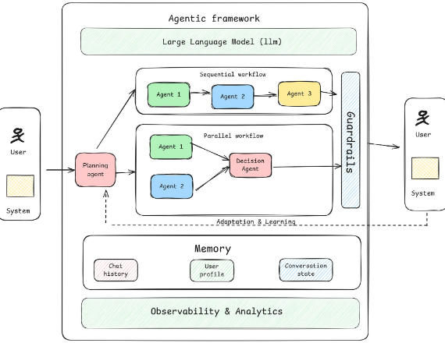

Agentic AI & LLM Integration
Role of Autonomous Agents
Automated risk scoring
Device classification
Threat prioritization
Intelligent security recommendations
Faster decision-making
Models & Frameworks Used
Python
Scikit-learn
Pandas
NumPy
FastAPI
Machine Learning Algorithms
Bootcamp on Intelligent Cyber Forensics
Gujarat Technological University

Slide 7


Implementation & Tools
Implementation Status
Tools & Tech Stack
:
. Programming Language
Python
Frameworks
FastAPI
HTML
CSS
JavaScript
Libraries
Scapy
Nmap
Pandas
NumPy
Scikit-learn
✔ Network Reconnaissance
✔ Firewall Detection
✔ IoT Discovery
✔ AI Risk Analysis
✔ Interactive Dashboard
✔ Automated PDF Report Generation
Bootcamp on Intelligent Cyber Forensics
Gujarat Technological University

Slide 8

Outcome & Demonstration
Key Achievements
Automated complete network security assessment
Integrated multiple security modules into one platform
AI-based risk analysis and reporting
Interactive dashboard for visualization
Professional PDF report generation
Demonstration
Network topology visualization
Active host discovery
Open port analysis
Firewall detection
IoT device identification
AI-generated risk scores
Bootcamp on Intelligent Cyber Forensics
Gujarat Technological University

Slide 9


Limitations & Future Scope
Current Limitations
Future Scope & Deployment
Some scans require administrator/root privileges.
Scan performance depends on network size.
Wireless analysis requires compatible hardware.
External threat intelligence integration is limited.
SIEM integration
Continuous network monitoring
Cloud deployment
Multi-user access
Real-time threat intelligence feeds
LLM-powered security assistant
Scope for real-world deployment
Bootcamp on Intelligent Cyber Forensics
Gujarat Technological University

Slide 10
GUJARAT TECHNOLOGICAL UNIVERSITY
Thank You!
AI-powered cyber forensics significantly enhances incident investigation efficiency and accuracy, empowering security teams to respond to modern threats at scale.
Final Presentation
24th July 2026
Gujarat Technological University

